Slide 1
Employee Attrition
By: Matt Tilley

Slide 2
Data
The data comes from Kaggle.com and can be found below:
https://www.kaggle.com/pavansubhasht/ibm-hr-analytics-attrition-dataset
It contains 35 different metrics and 1470 different people

Slide 3
Overall Correlation Take Aways
Avoid the Overtime Trap
Workers that have easily transferable skills are extra vulnerable to attrition
Work-Life Balance is very important to workers

Slide 4
Attrition Comparison (Overall, 30 and Under, Over 30) (Positive Correlations)
Similar Reasons but work-life balance seems even more important for younger people

Slide 5
Retention Comparison (Overall, 30 and Under, Over 30) (Negative Correlations)

Slide 6
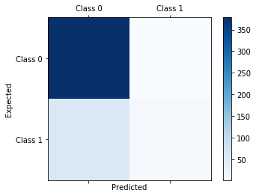
Initial Modeling Attempt
The initial model was accurate but essentially just guesses ‘Retention’ everytime.
When it did guess ‘Attrition’ it was wrong 75% of the time

Slide 7
Undersampling
Used to create an even balance between attrition and retention
Lost a lot of data because there were 237 examples of attrition and 1233 examples of retention
Performed at an average of 57% during cross sampling
Only correctly predicted attrition 6% of the time
Would most likely be the best long term model because it will become more accurate with more data

Slide 8
Oversampling
Created a much more accurate model (82% accuracy in cross validation)
Biggest concern is that the model overrepresents the 237 examples of attrition.
Will probably be significantly less accurate as time progresses

Slide 9
Potential Model Improvements
Having more data on people who leave

